Slide 1
Data mining models
Preslav Angelov, Huy Le, Evin Tolentino
BUAN 5510 – Ben Kim
06 August 2019
HOUSING & RESIDENTIAL SAFETY: THE IMPACT OF CRIME ON PROPERTY VALUE AND TAXES IN PIERCE COUNTY

Slide 2
Variable Selection
House attributes: SalePrice, Buildings, LandNetSquareFeet, SquareFeet, PhysicalAge, YearBuilt
Crime data: DrugCrime, Homicide, OtherCrime, PersonalCrime, PropertyCrime
Only include those houses which have sale data from 2018 – 2019.

Slide 3
Model Selection
Decision Tree
Neural Network
Random Forest
Build out models (Visual Studio & R)
Two sets of variables
One with crime variables
One without crime variable

Slide 4
Clustering (with crime)
Cluster 1 – Blue (82.95% of total): wide range, mid crime
Cluster 2 – Orange(15,9% of total): New and expensive, low crime
Cluster 3 – Red (1.6% of total):Mid-age, 1000~1500 sqrfeet, High crime

Slide 5
Clustering (without crime)
Cluster 1 – Blue (82.3% of total): >=1500 sqrfeet, >= 300,000$,Wide range attributes
Cluster 2 – Orange(11.06% of total): 200~300,000$, middle house
Cluster 3 – Red (6.91% of total): New, expensive

Slide 6
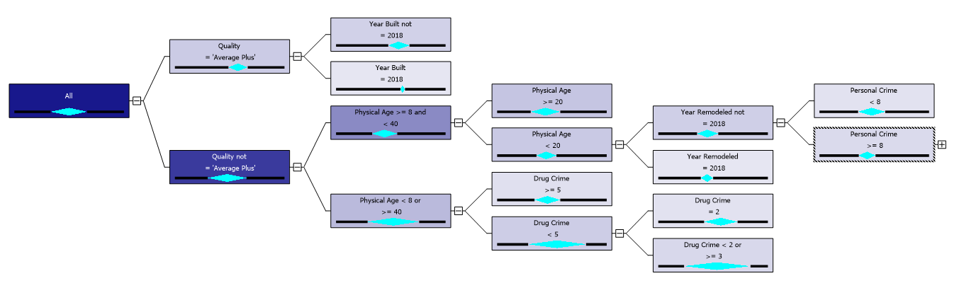
Decision Tree (with Crime)

Slide 7
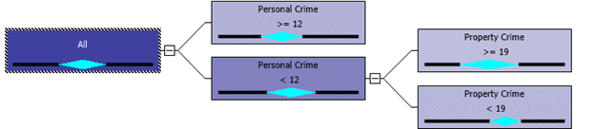
Decision Tree (with Crime)
In Cluster 2 (New, Expensive, low crime): Personal Crime and Property Crime are on top 2 level of tree.

Slide 8

Decision Tree (with Crime)
In Cluster 3 (mid-age, high crime)

Slide 9
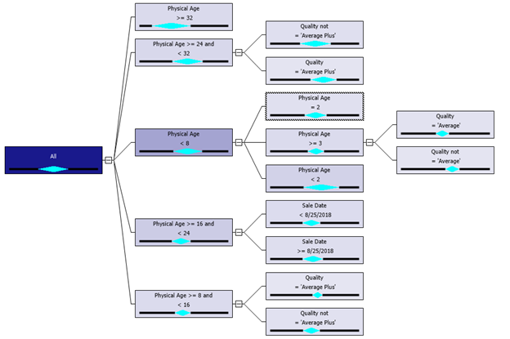
Decision Tree (without Crime)

Slide 10
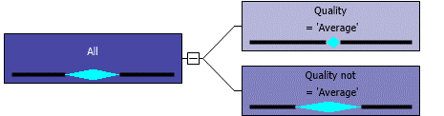
Decision Tree (without Crime)
Cluster 2 -200~300,000$, middle house

Slide 11
Decision Tree (without Crime)
Cluster 3 -New, expensive

Slide 12
Neural Network
Modeling data with 2 model:
Normalize data
Separated models with 3 clusters
Using 2 dataset with and without crime data
1 hidden layer with 4 nodes
2 hidden layer with 4 and 2 nodes

Slide 13
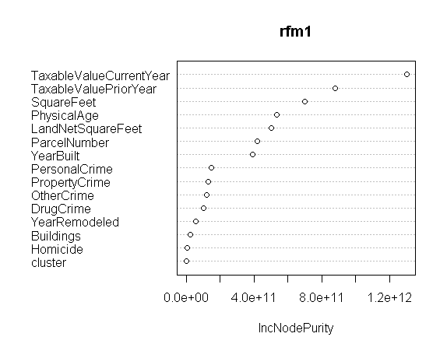
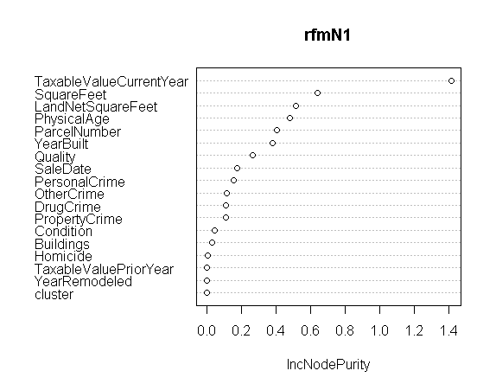
Random Forest (Cluster 1 – With Crime)
Denormalized
Normalized

Slide 14
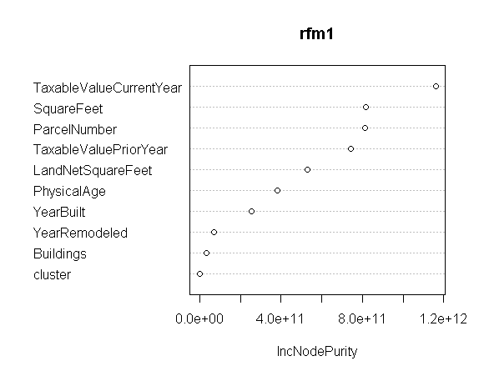
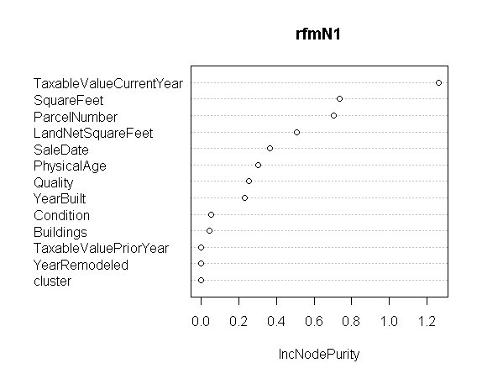
Random Forest (Cluster 1 – Without Crime)
Denormalized
Normalized

Slide 15
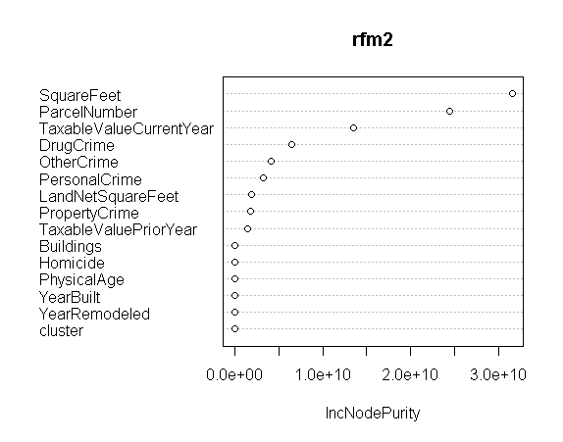
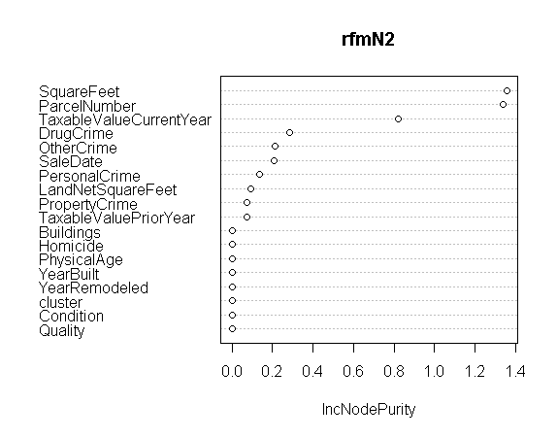
Random Forest (Cluster 2 – With Crime)
Denormalized
Normalized

Slide 16
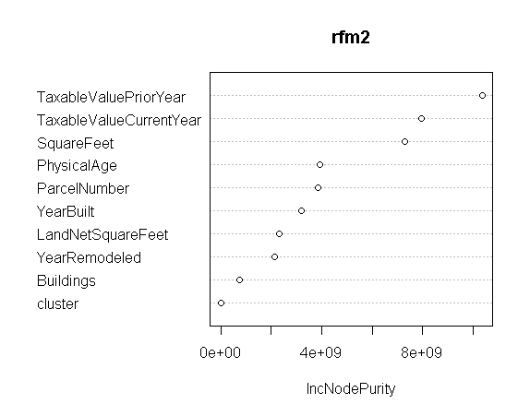
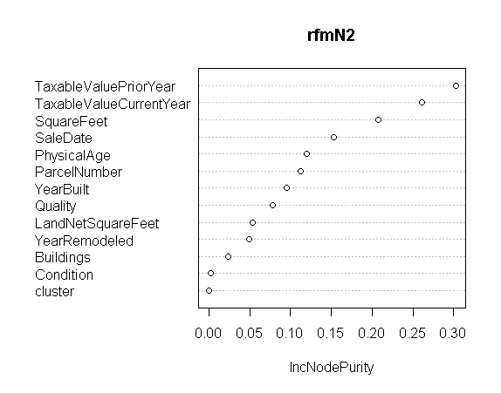
Random Forest (Cluster 2 – Without Crime)
Denormalized
Normalized

Slide 17
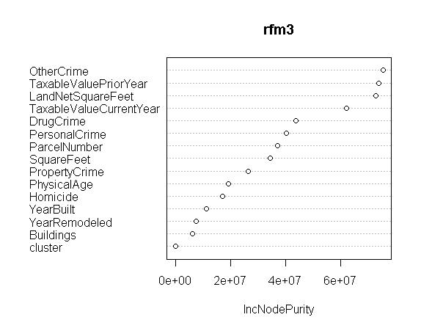
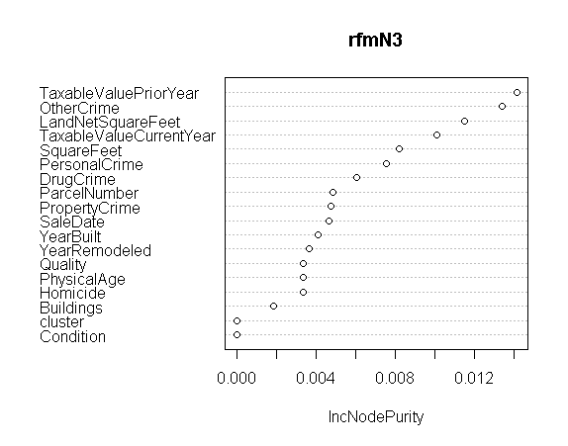
Random Forest (Cluster 3 – With Crime)
Denormalized
Normalized

Slide 18
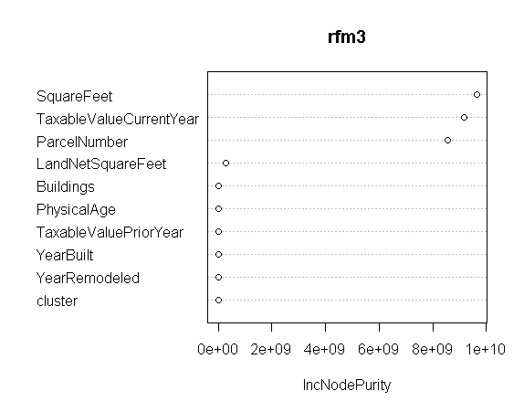
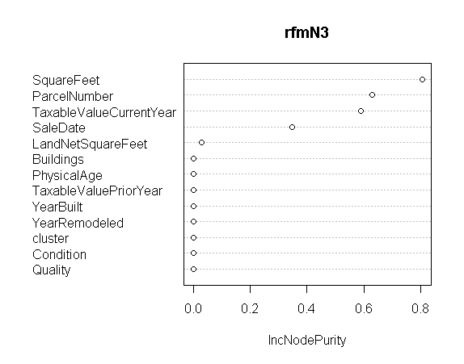
Random Forest (Cluster 3 – Without Crime)
Denormalized
Normalized

Slide 19
Model Evaluation
Decision Tree (MSE)
Model |  | Actual RMSE
 |  | with crime | without crime
Decision Tree | Cluster 1 | 135670.9288 | 140470.9636
 | Cluster 2 | 9962.5435 | 42408.9308
 | Cluster 3 | 7814.5471 | 8874.1204

Slide 20
Model Evaluation
Neural Network (MSE)
Model |  |  | MSE |  | Actual RMSE
 |  |  | with crime | without crime | with crime | without crime
Neural network | Cluster 1 | 1 layer | 0.0156 | 0.0078 | 131328 | 92693.1
 |  | 2 layers | 0.0156 | 0.0099 | 131328 | 104718
 | Cluster 2 | 1 layer | 0.000039 | 0.0021 | 50256.8 | 95541.2
 |  | 2 layers | 0.0001 | 0.0018 | 50632.5 | 95113.3
 | Cluster 3 | 1 layer | 0.00013 | 0.00014 | 36252.3 | 49916.9
 |  | 2 layers | 0.0063 | 0.00011 | 42031.1 | 49596

Slide 21
Model Evaluation
Random Forest (MSE – Training Data)
Model |  | MSE (normalized) |  |  |  | MSE (denormalized)
 |  | with crime | % Var explained | without crime | % Var explained | with crime | % Var explained | without crime | % Var explained
Random Forest | Cluster 1 | 0.007321162 | 53.08 | 0.00695791 | 57 | 8309309032 | 51.79 | 8005929746 | 55.21
 | Cluster 2 | 0.009365744 | 89.13 | 0.03861025 | 4.21 | 163728590 | 90.37 | 1152898116 | 6.61
 | Cluster 3 | 0.06301088 | -73.97 | 0.00948439 | 91.9 | 280783644 | -58.21 | 156517649 | 89.88
Cluster 1: 312 records (with crime) & 308 records (without crime)
Cluster 2: 55 records (with crime) & 40 records (without crime)
Cluster 3: 4 records (with crime) & 24 records (without crime)

Slide 22
Model Evaluation
Random Forest (MSE – Testing Data)
Model |  | MSE (normalized) |  | MSE (denormalized)
 |  | with crime | without crime | with crime | without crime
Random Forest | Cluster 1 | 0.004554299 | 0.007933904 | 5001058413 | 9155102497
 | Cluster 2 | 0.003836564 | 0.04431907 | 68025131 | 1293541841
 | Cluster 3 | -0.1984221 | 0.01999079 | -6.176113e+13 | 318428907
Cluster 1: 79 records (with crime) & 78 records (without crime)
Cluster 2: 14 records (with crime) & 10 records (without crime)
Cluster 3: 2 records (with crime) & 6 records (without crime)

Slide 23
What's Next?
Possibly creating a new dataset
Integrating SalePrice information provided less than 500 records of data (too small?)
Revisiting clustering method
Define possible new dependent variable (SalePrice vs. Market Value of a home in Pierce County)

